Slide 1
18ECO134T – Sensors and Transducers
Unit III : Session 3 : SLO 2
SRM Institute of Science and Technology
‹#›
Notes:
Pl use Font Family : Arial Narrow
To enhance the teacher presentations and the overall comprehension of students, it allows to present their lessons in a more dynamic and effective way. Set a Learning Objective:
1. Write an Outline for Key Ideas
2. Give the Presentation About Education a "Why"
3. Share Techniques and Tips for the Topic
4. Teach With Visualizations
5. Use Animations Carefully
‹#›

Slide 2
Thermocouple construction

Slide 3
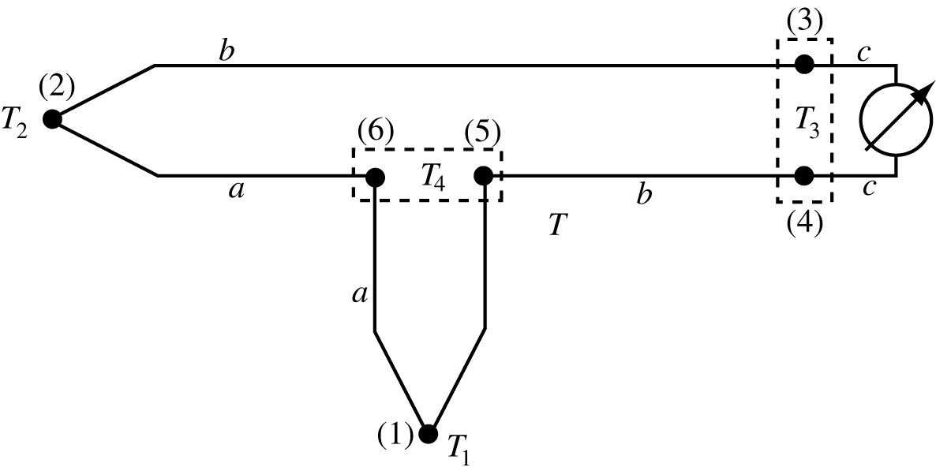
Thermocouples: connection
Based on the thermoelectric laws:
Usually connected in pairs
One junction for sensing
One junction for reference
Reference temperature can be lower or higher than sensing temperature
Notes:
‹#›
52

Slide 4
Thermocouples (cont.)
Any connection in the circuit between dissimilar materials adds an emf due to that junction.
Any pair of junctions at identical temperatures may be added without changing the output.
Junctions 3 and 4 are identical (one between material b and c and one between material c and b and their temperature is the same. No net emf due to this pair
Junctions (5) and (6) also produce zero field
Notes:
‹#›
53

Slide 5
Thermocouples (cont.)
Each connection adds two junctions.
The strategy in sensing is:
For any junction that is not sensed or is not a reference junction:
Either each pair of junctions between dissimilar materials are held at the same temperature (any temperature) or:
Junctions must be between identical materials.
Also: use unbroken wires leading from the sensor to the reference junction or to the measuring instrument.
If splicing is necessary to extend the length, identical wires must be used to avoid additional emfs.
Notes:
‹#›
54

Slide 6
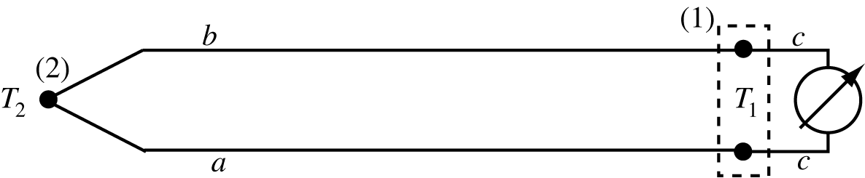
Connection without reference
The connection to a voltmeter creates two junctions
Both are kept at temperature T₁
Net emf due to these junctions is zero
Net emf sensed is that due to junction (2)
This is commonly the method used
Notes:
‹#›
55

Slide 7
Reference junctions
Reference junctions must be at constant, known temperatures. Examples:
Water-ice bath (0°C)
Boiling water (100°C)
Any other temperature if measured
A separate, non-thermocouple sensor
The output compensated based on this temperature from Seebeck coefficients
Notes:
‹#›
56

Slide 8
Thermocouples - practical considerations
Choice of materials for thermocouples. Materials affect:
The output emf,
Temperature range
Resistance of the thermocouple.
Selection of materials is done with the aid of three tables:
Thermoelectric series table
Seebeck coefficients of standard types
Thermoelectric reference table
Notes:
‹#›
57

Slide 9
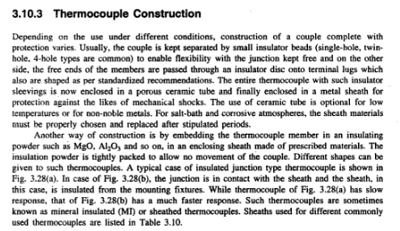

Slide 10
